Slide 1

SALES ANALYSIS
Neethu Sunitha Pradeepan

Slide 2
Business Understanding
The dataset is about three years of sales data. There is a Dimension Data where there is the list of companies and their Line of Business. There is also a Target Data.
Analysis include important KPIs ,sales over time, sales over various products, manager wise analysis ,customer coverage across various locations and target analysis
EDA is used to get meaningful insights from the data given and proving recommendations on how to improve the Business

Slide 3

Understanding the data

Slide 4
DATA CLEANING
Python is used for data cleaning and to get univariate and bivariate analysis
Data cleaning activities like Handling Missing Values, Standardizing and Formatting,
Handling Outliers and data type conversion are done in Python

Slide 5
Insights
Total customer count is 1411 and out of that 1364 are active customers and 47 are inactive customers
As per the sales data Market Lv1 has the highest number of active customers for the Line of Business and Wholesales Lines of Business has the least number of active customers
Winthrop city has the highest number of active customers and that is 375

Slide 6
Insights
Total Sales made is 17.91 Million and total quantity sold is 6 Million
Target sale is 23.83 Million whereas the actual sale is 17.91 Million
Total transaction placed is 260 k
Maximum Sale -Peak is in the month of October (1.17M) and (785 K )respectively for 2018 and 2017 and least sale is in the month of February

Slide 7
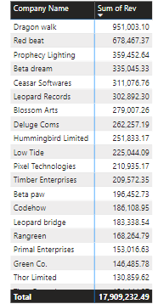
Customer analysis
Dragon Walk has made the highest sale followed by Red beat
Supermarket Lv3 has made the highest sale of (3.6M) in the Line
of Businesses followed by B and Bs
The highest sale is in the city Yoman about 3.38M followed by
Winthrop of 2.28M

Slide 8
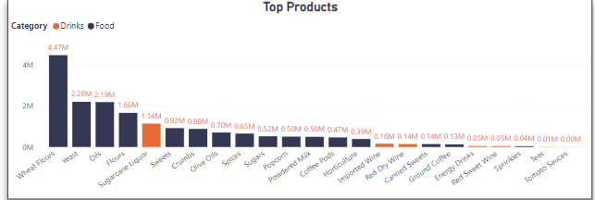
PRODUCT ANALYSIS
Main category of sale is Food and Drinks
Food is 16.73M(91.39%) whereas Drink is 1.54M(8.61%)
Wheat Flour has made the highest sale among other products followed by Yeast

Slide 9
SALES PERFORMANCE ANALYSIS
Sales by Team-Retail is 8.70 M ,Distributer is 6.10 M and Online is 3.1M
Manager base analysis-Online and Distributer sale is managed by Duane Frame and Retail is managed by Ronnie Daly
Duane Frame sold 9.21 M (51.44%)and Ronnie Daly sold 8.7 M (48.56%)
Salesperson ID 215 made the highest sale in 2017 of (4.70M )as well as 2018 of (5.24M)
Total sale made is 17.91 M

Slide 10
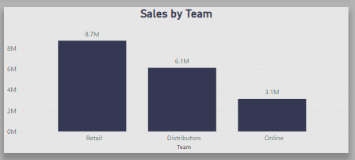
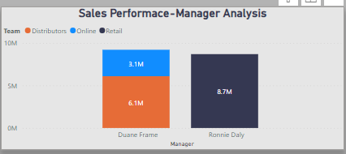
SALES PERFORMANCE ANALYSIS

Slide 11
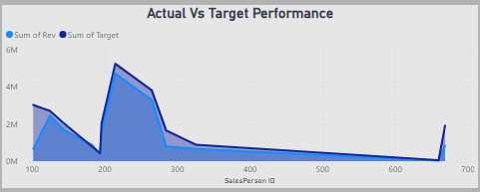
Actual sale vs target sale
Target sale is 23.83 Million whereas the actual sale is 17.91 Million

Slide 12
CONCLUSION
Total Sales made is 17.91 Million
Total Sale in 2017 was 6.65M and that increased to 10.21M in 2018
Sales data from 2019 is incomplete
Maximum sale in 2017 and 2018 is in the month of October (Peak Time)
Sales by retail has made the highest sales in comparison to online and distributers

Slide 13
Conclusion
Dragon Walk has made the highest sale followed by Red beat
Supermarket Lv3 has made the highest sale of (3.6M) in the Line
of Businesses followed by B and Bs
The highest sale is in the city Yoman about 3.38M followed by
Winthrop of 2.28M
Main category of sale is Food and Drinks
Food is 16.73M(91.39%) whereas Drink is 1.54M(8.61%)
Wheat Flour has made the highest sale among other products followed by Yeast

Slide 14
Thank you

